Slide 1
The Future of Methodism: Homosexuality And The United Methodist Church

Slide 2
The United Methodist Church
Formed on April 23, 1968 as a merger of the Evangelical United Brethren and Methodist denominations.

Slide 3
Conference
General (every 4 years)
Episcopacy
Bishops oversee churches and pastors in annual conferences
Meet collectively in annual Council of Bishops Primary powers are appointing clergy and providing leadership to an annual conference.
Judicial
Jurisdictional / Central (every 4 years)
Annual (every year) Most major decisions are made by Conference.
Judicial Council Primary purpose of Judicial Council is to make rulings about the constitutionality of various actions and decisions.

Slide 4
General Conference
Highest legislative body in The United Methodist Church.
It meets every four years.
It is the only body that can speak for the entire denomination.

Slide 5
Changing Attitudes (1970s)
The American Psychiatric Association removed “homosexuality” from the diagnostic manual of mental illness in 1973.
A few UMC congregations – such as Glide Memorial in San Francisco – supported the emerging Gay Liberation Movement

Slide 6
1972 Social Principle Statement
"Homosexuals no less than heterosexuals are persons of sacred worth, who need the ministry and guidance of the church in their struggles for human fulfillment, as well as the spiritual and emotional care of a fellowship which enables reconciling relationships with God, with others, and with self. Further we insist that all persons are entitled to have their human and civil rights ensured, although we do not condone the practice of homosexuality and consider this practice incompatible with Christian teaching."

Slide 7
Human Sexuality (¶ 162.G.)
”We affirm that all persons are individuals of sacred worth, created in the image of God. All persons need the ministry of the Church in their struggles for human fulfillment, as well as their spiritual and emotional care of a fellowship that enables reconciling relationships with God, with others, and with self. The United Methodist Church does not condone the practice of homosexuality and considers this practice incompatible with Christian teaching. We affirm that God’s grace is available to all. We will seek to live together in Christian community, welcoming, forgiving, and loving one another, as Christ has loved and accepted us. We implore families and churches not to reject or condemn lesbian and gay members and friends. We commit ourselves to be in ministry for and with all persons.”
-2016 UMC Book of Discipline

Slide 8
What is a Social Principle?
“The Social principles, while not to be considered church law, are a prayerful and thoughtful effort on the part of the General Conference to speak to the human issues in the contemporary world from a sound biblical and theological foundation as historically demonstrated in United Methodist traditions.”
- “Preface” to Part V. Social Principles, Book of Discipline (2016), 105.

Slide 9
1976 Addition to the Book of Discipline (¶ 613)
“No board, agency, committee, commission, or council shall give United Methodist funds to any ‘gay caucus’ or group or otherwise use such funds to promote the acceptance of homosexuality.”
[Financial Administration}
In favor | Against
39 | 31

Slide 10
1984 Addition to the Book of Discipline (¶304.3)
“Since the practice of homosexuality is incompatible with Christian teaching, self-avowed practicing homosexuals are not to be accepted as candidates, ordained as ministers, or appointed to serve in The United Methodist Church.”
[Legislative Committee; Standards for Ordination]
In favor | Against
79 | 22

Slide 11
1996 Addition to the Book of Discipline (¶341.6)
"Ceremonies that celebrate homosexual unions shall not be conducted by our ministers and shall not be conducted in our churches.”
In favor | Against
553 | 321

Slide 12
Overview – Book of Discipline
All are created in God’s image and invited into membership in UMC
Equal legal rights should be given regardless of sexual orientation.
Homosexuality is incompatible with Christian teaching.
“Self-avowed, practicing, homosexuals” cannot be appointed or ordained for ministry.
Same sex weddings cannot be performed in UMC churches or by UMC clergy.
No UMC funds are to be used to support gay caucuses or groups or promote acceptance of homosexuality OR violate the commitment of UMC “not to reject or condemn lesbian gay members and friends.”

Slide 13
Caucuses and The UMC
Parachurch organizations (advocacy groups) have been influential in galvanizing support or opposition to LGBT ordination and marriage.

Slide 14
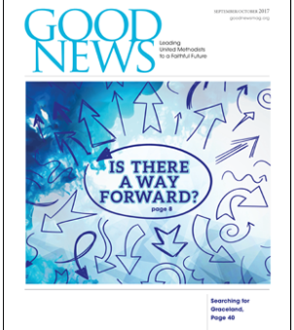
Leading Advocacy Groups
Good News (1967): leading evangelical-renewal caucus and has led the opposition to gay marriage and ordination since the 1980s.
Reconciling Ministries Network (1983): leading advocacy group for inclusion of LGBT members.

Slide 15
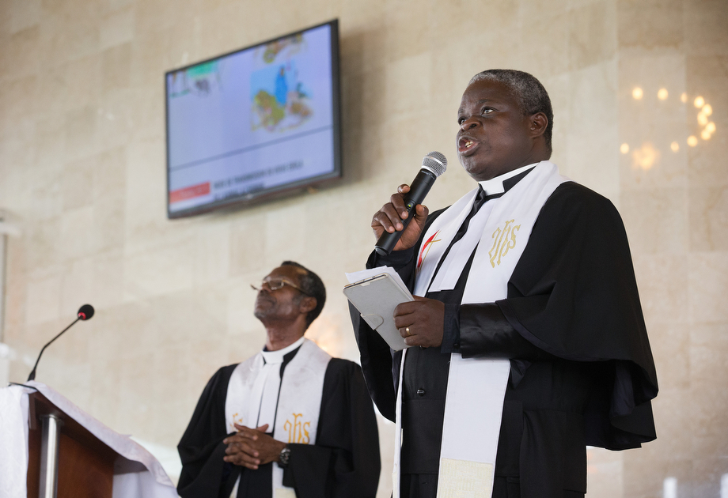
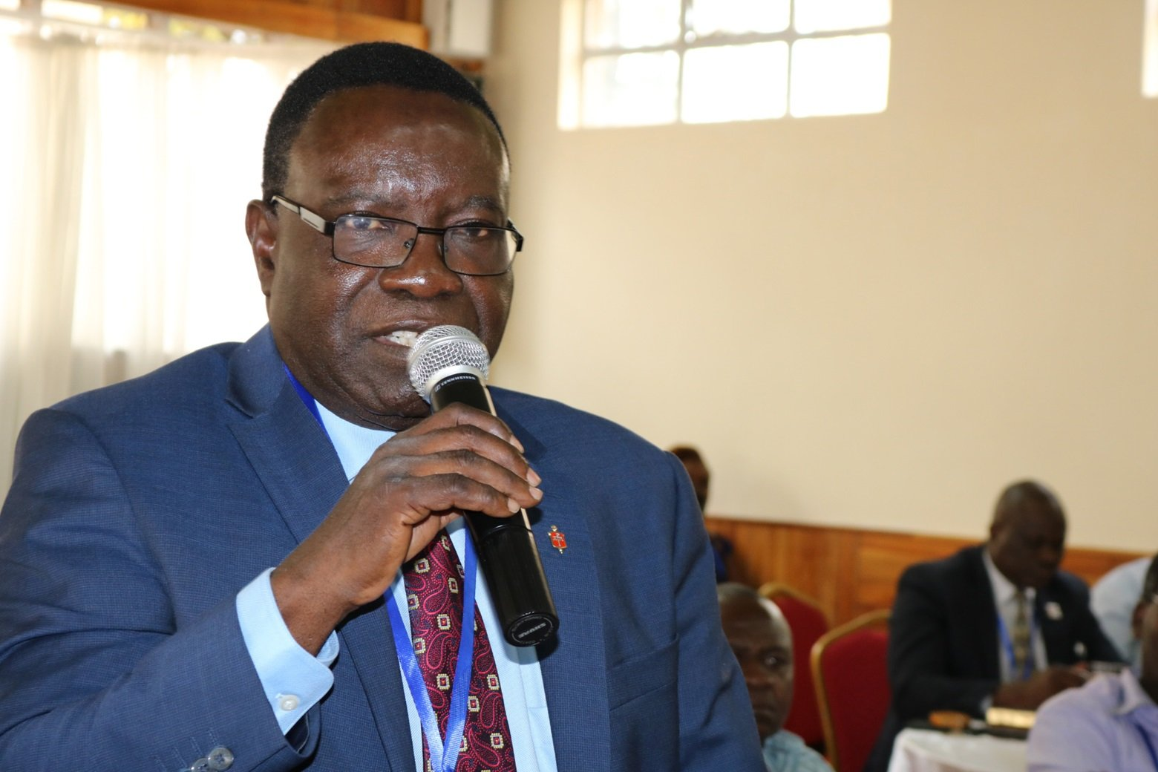
Growing International Witness
The Protestant Methodist Church of Côte d’Ivoire entered the UMC as an official episcopal area (2008).
The UMC has also seen substantial growth in other parts of Africa, such as the Republic of Congo.

Slide 16
2020 Delegates by Region
2016/19 Delegates by Region
Region | Percentage
United States | 58.3%
Africa | 30%
Philippines | 5.8%
Europe | 4.6%
”concordat churches” | 1.3%
Region | Percentage
United States | 55.9%
Africa | 32%
Philippines | 6%
Europe | 4.6%
”concordat churches” | 1.5%

Slide 17
2008 General Conference
Replace incompatibility clause with “Faithful, thoughtful people who have grappled with the issue deeply disagree with one another; yet all seek a faithful witness”
In favor | Against
416 | 516
Maintain incompatibility clause.
In favor | Against
501 | 417

Slide 18
Defeated 2012 Proposal
To change language of Social Principles to include that church members differ about "whether homosexual practices (are) contrary to the will of God."
In favor | Against
46% | 54%
Resolution that acknowledged a "limited understanding" of human sexuality and called on the church to "refrain from judgment regarding homosexual persons and practices until the Spirit leads us to new insight."
In favor | Against
39% | 61%

Slide 19
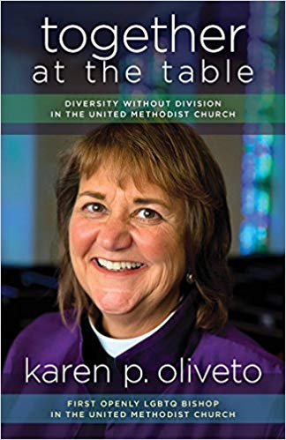
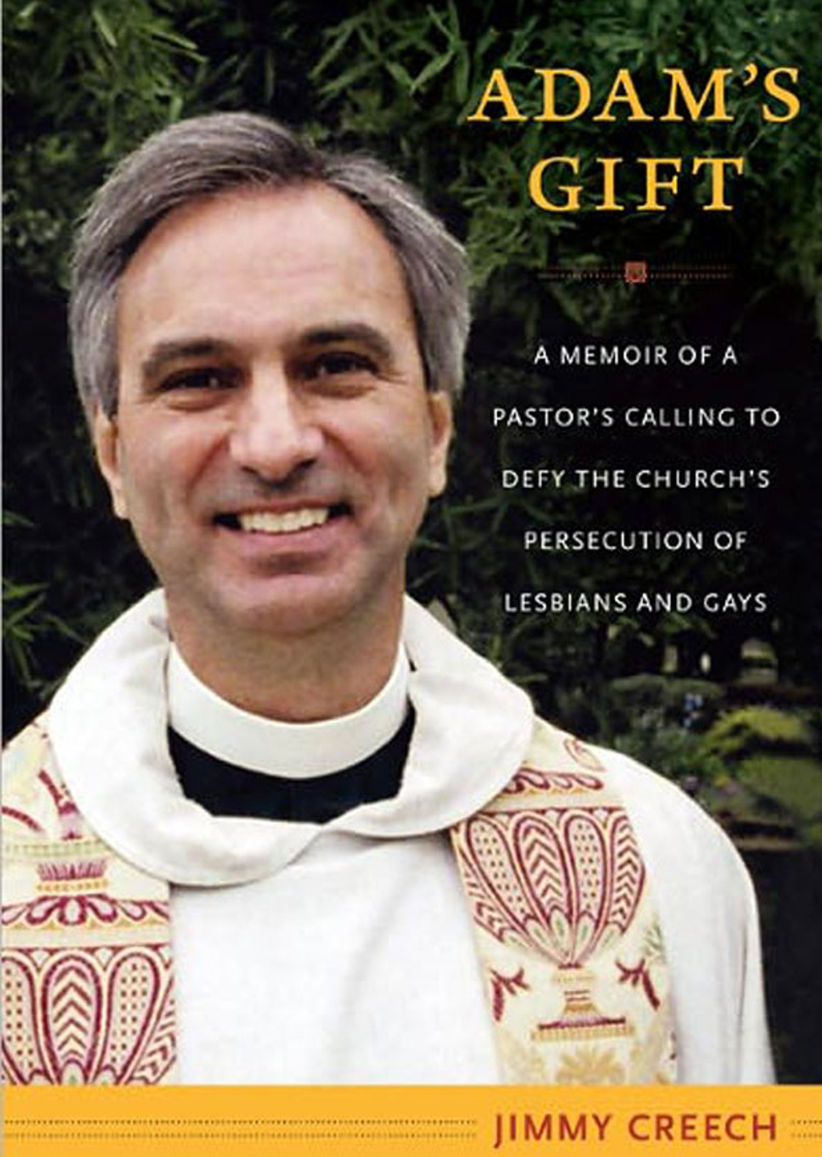
Did these votes settle the issue?
Pastors (including Jimmy Creech in 1997) performed same-sex weddings.
Some annual conferences ordained, licensed, or commissioned gay clergy.
Bishop Karen Oliveto was elected to the episcopacy by the Western Jurisdiction in 2016.

Slide 20
Criticisms from Traditionalists | Criticisms from Progressives
Bishops have not enforced rules about homosexuality consistently. Progressive actions (deliberately breaking rules in Discipline, protesting during General Conference, etc.) are disrespectful and show disregard for our polity. We are not biased against LGBT people; we simply want to respect Scripture | Unjust rules and laws should not be followed. Conservative caucuses have worked to stir up discord and manipulate the global South, through actions like the African Initiative. We take the Scripture seriously as well.

Slide 21
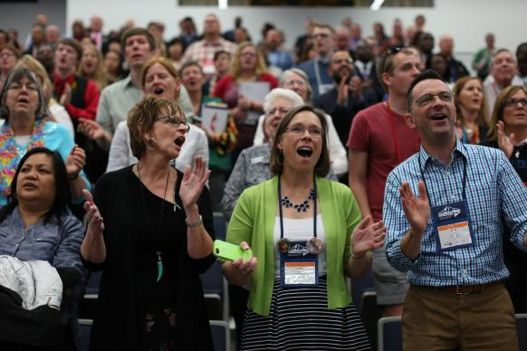
2016 General Conference May 10-20 Portland, Oregon
Delegates voted (428-405) to allow bishops to put together a special commission to examine and make possible recommendations to Book of Discipline related to human sexuality.

Slide 22
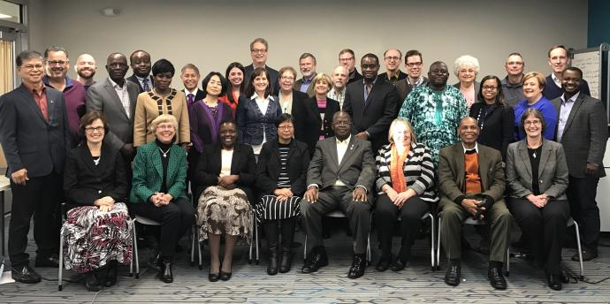
Commission on the Way Forward
Focused on three models - a traditionalist plan, a connectional church plan, and a one church plan.
All three models were voted on at special session of General Conference in 2019.

Slide 23
2019 General Conference February 24-26 in St. Louis, Missouri
The Traditional Plan was passed by the delegates.
In favor | Against
438 | 384

Slide 24
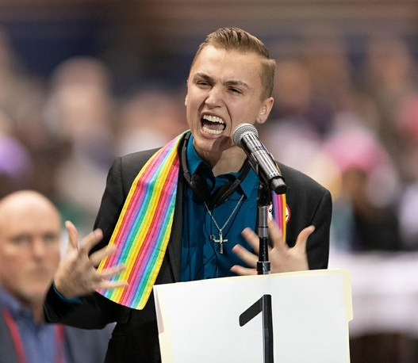
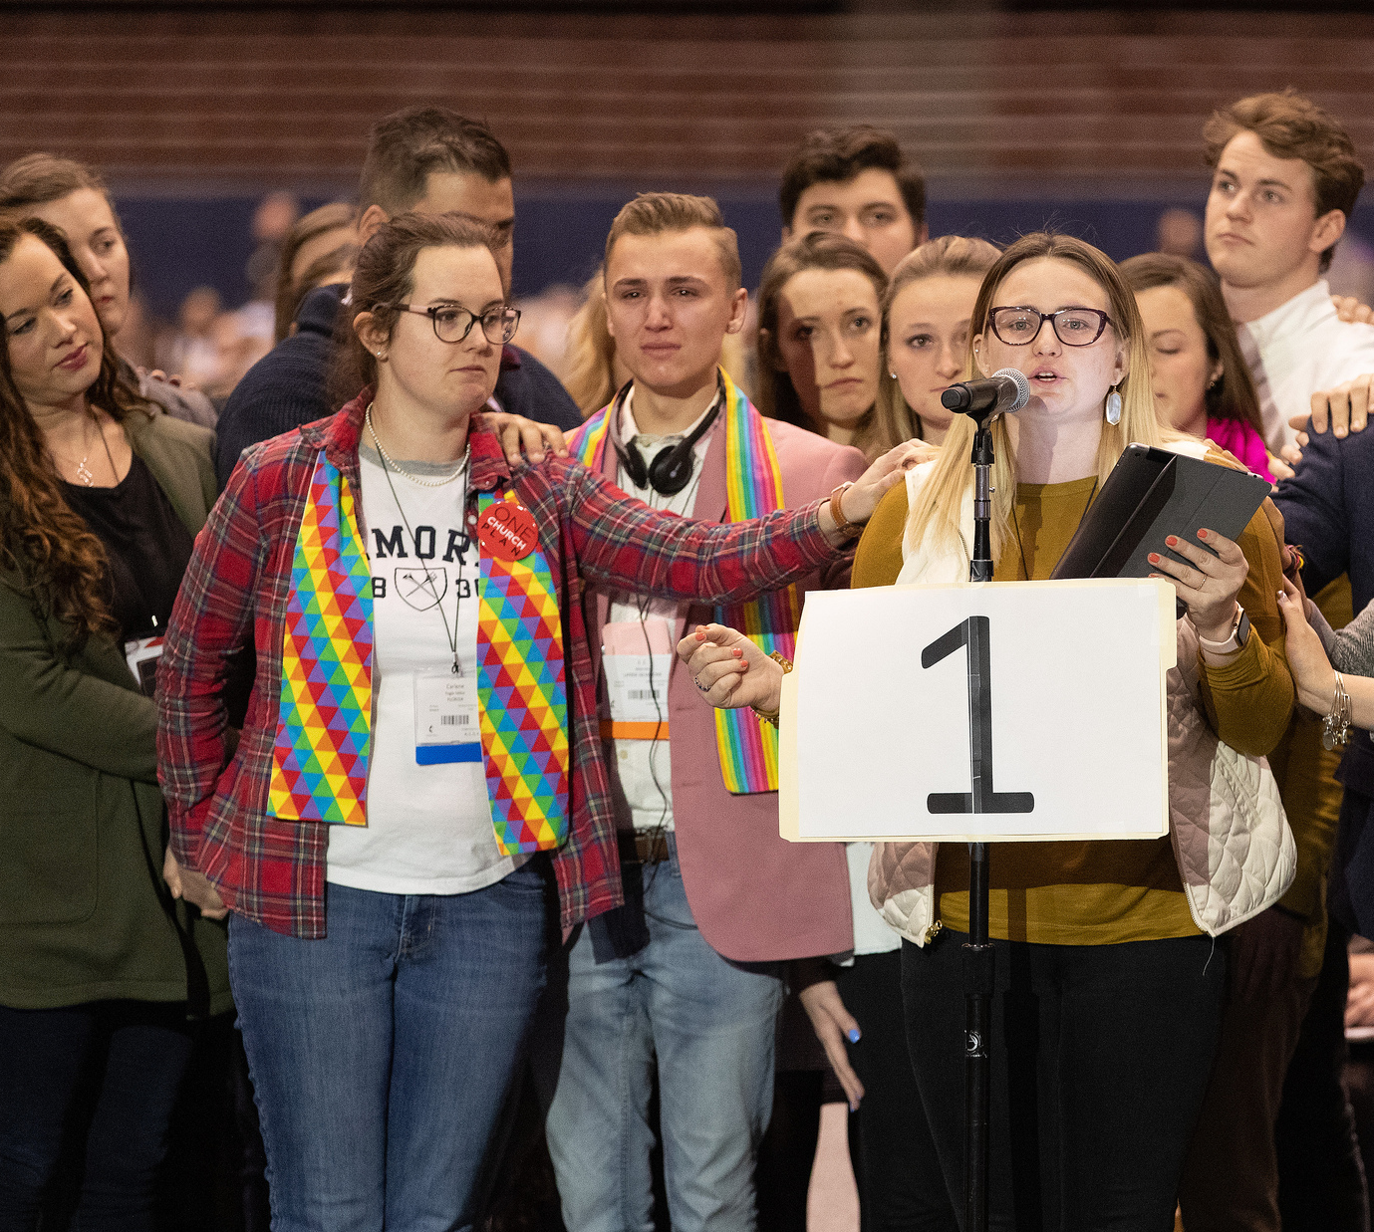
Young People’s Statement
Over 13 hours, 15,529 unique young people signed a statement to General Conference urging the election of more young delegates and the passing of the One Church Plan.
They argued, “This plan is not as far progressive as some of us would like, and is not as conservative as some would like. And yet this is a space where we can come together.”

Slide 25
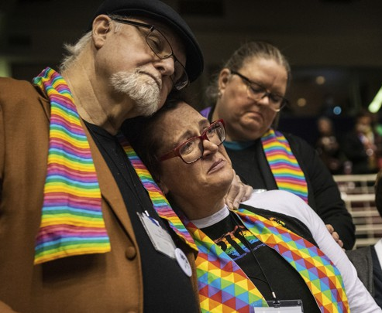
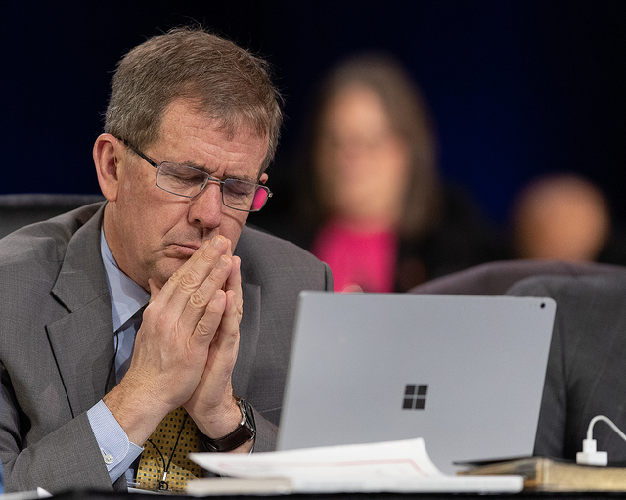
The Way Forward?
“This decision is consistent with our denomination’s historic stance on human sexuality… I pray we, as a denomination, can now move forward, working with each other in the spirit of Christian love and joining together as one. We are stronger together in serving God’s mission as a diverse body of Christ.”
– Bishop Scott Jones
“

Slide 26
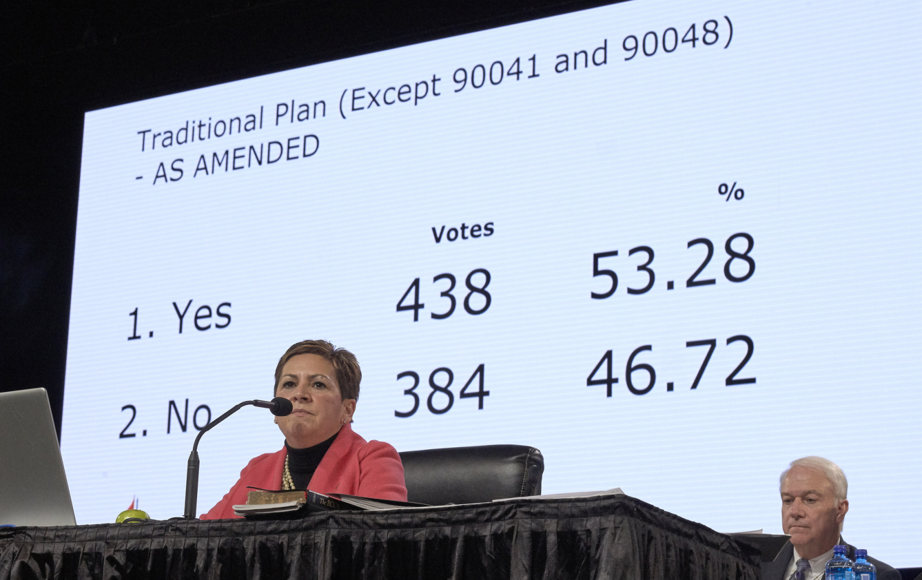
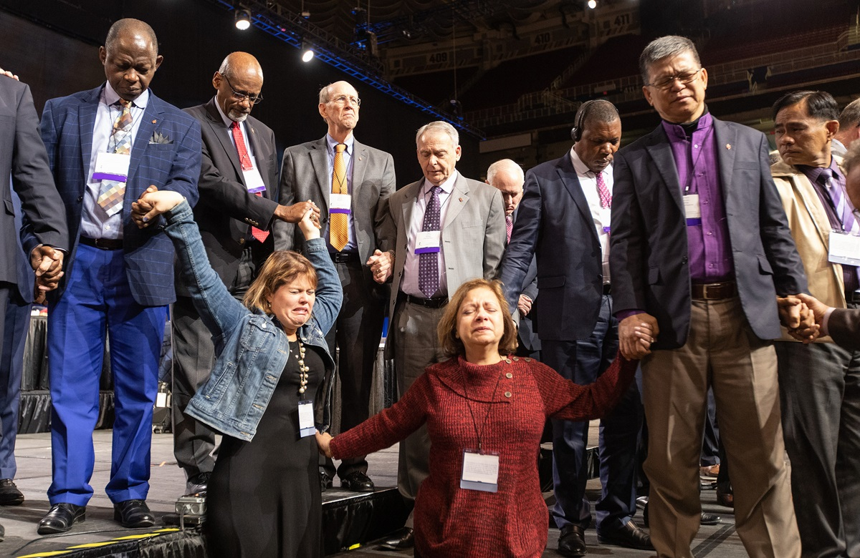
“Most difficult to predict is the future of evangelical Methodism. What does a dog do when he finally catches the car he has been chasing? We evangelicals never really wanted to inherit the institution, we were just contending for the faith. The UMC is a house past due for a major remodel. I expect the crisis of the next couple years won’t be wasted and a very different wineskin will form.”
– Rev. Chris Ritter, delegate, Illinois Great Rivers Conference

Slide 27
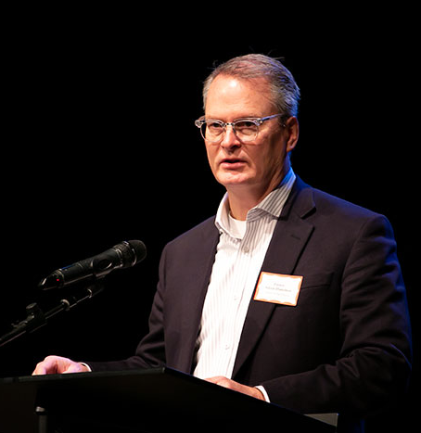
“…the coalition that leaders of the WCA put together … hurt, once more, our LGBTQ members, their families and friends. They have harmed United Methodism’s witness in America. They will have negatively impacted our mission work in the world. They have significantly impacted our ministry with young adults and the generations that follow …. I will not treat my gay and lesbian people as second class. I will not quietly accept the way backwards as an acceptable way for us to live together as United Methodists.” -Adam Hamilton, Pastor of Church of the Resurrection

Slide 28
What went into effect in January?
“self-avowed practicing homosexual” was expanded to include those “living in a same-sex marriage, domestic partnership or civil union, or is a person who publicly states she or he is a practicing homosexual.”
(Pet # 90032, Footnote 1 Qualifications for Ministry - ¶ 304.3)

Slide 29
What went into effect in January?
Bishops are prohibited from consecrating, commissioning, or ordaining people who are self-avowed homosexuals. (90036 #5)
The District Committee on Ordained Ministry and Board of Ordained Ministry cannot recommend for candidacy, licensing, commissioning or ordination, someone who does not meet the qualifications for ordained ministry. (90043 #12)
When a complaint/charge is brought to the Bishop regarding a violation, the Bishop has discretion about how to proceed. Now, the Bishop cannot dismiss the complaint, unless it has no basis in law or fact. (90044 #13)

Slide 30
What went into effect in January?
Mandatory Minimum Penalties for clergy who have been convicted of conducting same-sex weddings or celebrations of homosexual unions. First offense – one year suspension without pay. Second offense – termination of conference membership and revocation of credentials. (90042 #11)

Slide 31
The Trust Clause ¶ 2501
Each congregation’s property is held in trust, for the benefit of the entire denomination.
Property cannot be sold, bought, or substantially changed without the involvement of the district superintendent and the district site committee.

Slide 32
Disaffiliation of Local Churches Over Issues Related to Human Sexuality ¶ 2553
The disaffiliation resolution must be approved by a two-thirds majority of the professing members of the local church present and voting at the church conference.
The conference board of trustees establishes the terms and conditions, including the effective date, of the agreement between the annual conference and the exiting local church in accordance with applicable church law and civil laws.
The disaffiliation agreement must be ratified by a simple majority of the members of the annual conference present and voting.

Slide 34
Major Plans Being Discussed
There are several plans that may be discussed at General Conference.
These include: Indianapolis Plan, New Expressions Worldwide (UM Forward), and Next Generation UMC (UMCNext).

Slide 35
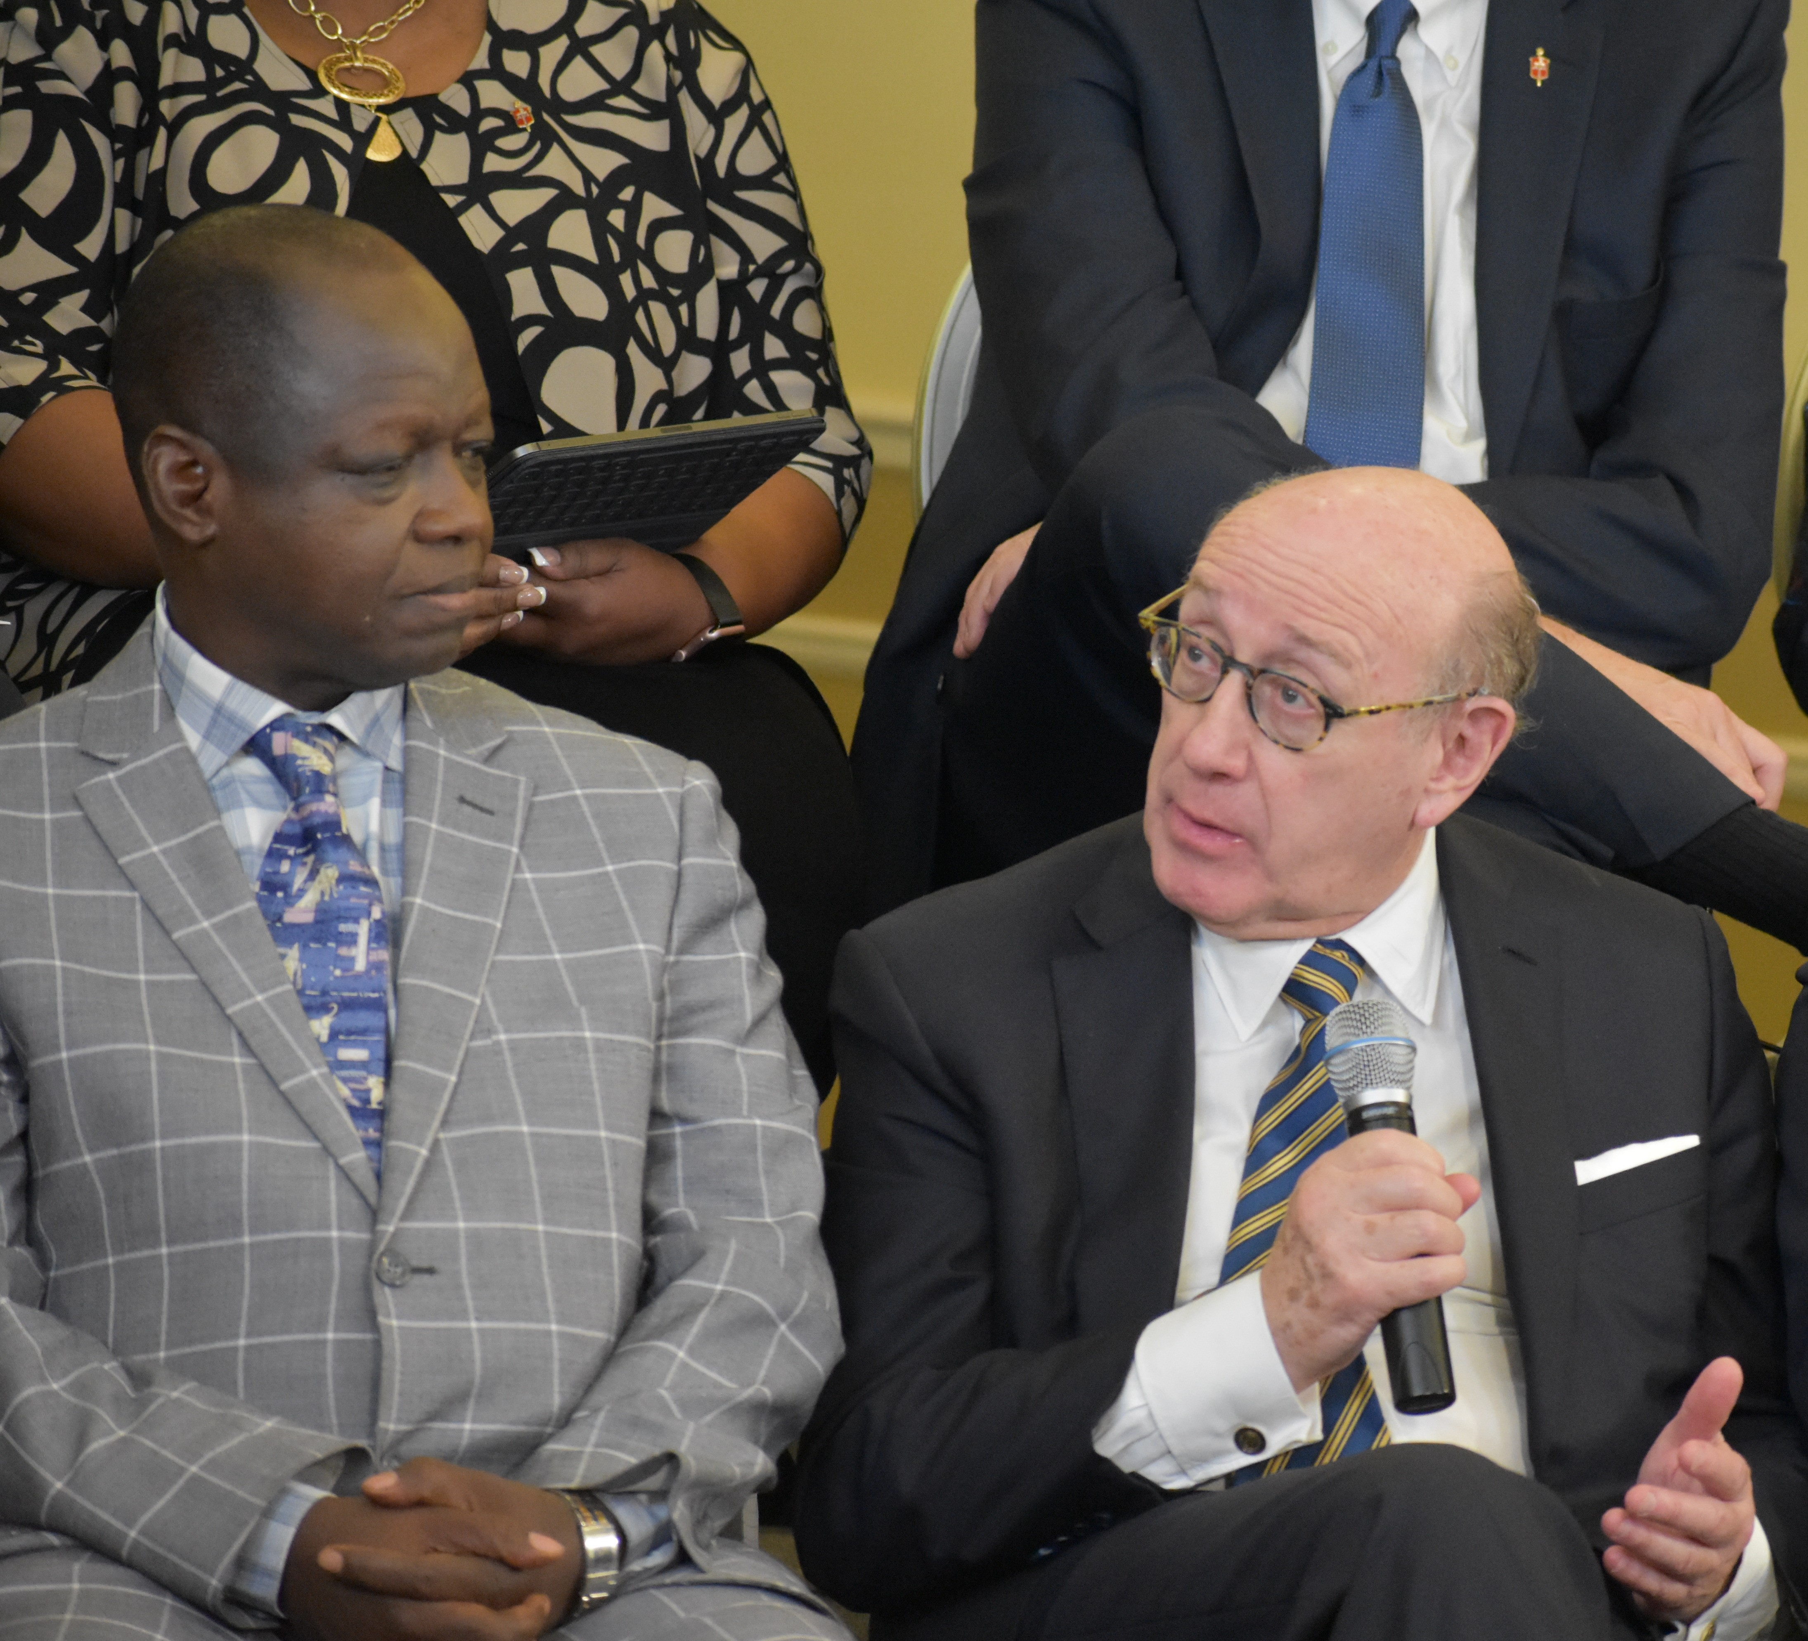
Protocol of Reconciliation & Grace Through Separation
Mediated by Kenneth Feinberg (who mediated September 11th Victim Compensation Fund)
Initiated by 3 Central Conference bishops (Africa, Europe, Asia).

Slide 36
Protocol of Reconciliation & Grace Through Separation
“The United Methodist Church and its members aspire to multiply the Methodist mission in the world by restructuring the Church through respectful and dignified separation. “

Slide 37
Who signed it?
8 bishops (3 from Central Conferences; 5 from the U.S.)
A clergy person from the Philippines.
8 representatives from caucuses including UM Next, WCA, Good News, RMN.

Slide 38
Bishop Christian Alsted (Nordic-Baltic Episcopal Area)
Rev. Thomas Berlin (UMCNext)
Bishop Thomas J. Bickerton (New York Episcopal Area)
Rev. Keith Boyette (Confessing Movement, Good News, Institute on Religion & Democracy, and the Wesleyan Covenant Association)
Bishop Kenneth Carter (Florida Episcopal Area)
Rev. Junius Dotson (UMCNext, Mainstream UMC)
Bishop LaTrelle Easterling (Washington Episcopal Area)
Rev. Egmedio “Jun” Equila, Jr. (Philippines Central Conference)
Bishop Cynthia Fierro Harvey (Louisiana Episcopal Area)
Bishop Rodolfo “Rudy” Juan (Davao Episcopal Area, Philippines)
Janet Lawrence (Affirmation, Methodist Federation for Social Action, and Reconciling Ministries Network)
Rev. David Meredith (Affirmation, Methodist Federation for Social Action, and Reconciling Ministries Network, member of United Methodist Queer Clergy Caucus)
Patricia Miller (Confessing Movement, Good News, Institute on Religion & Democracy, and the Wesleyan Covenant Association)
Dr. Randall Miller (Affirmation, Methodist Federation for Social Action, and Reconciling Ministries Network)
Bishop Gregory Vaughn Palmer (Ohio West Episcopal Area)
Bishop John K. Yambasu (Sierra Leone Episcopal Area)

Slide 39
Who consulted?
While not signatories, a number of other. participants were involved in an initial 2019 meeting:
Maxie Dunnam (Confessing Movement) Ginger Gaines-Cirelli (UMNext) Adam Hamilton (UMNext) Dr. Mark Holland (Mainstream UMC) Bishop Mande Muyambo, North Katanga Karen Prudente (MIND) Rob Renfroe (Good News) Kimberly Scott (UM Queer Clergy) Jasmine R. Smothers (UMNext) Mark Tooley (IRD)

Slide 40
Denominations | At least 2 - UMC and a new traditionalist body
Who Joins New Denomination | Annual Conferences by votes of 57% Central Conferences by vote of 2/3rds Local churches by vote of 2/3 may choose different denomination than Annual Conference.
Requirements | Plan is only viable if entire plan is deemed constitutional (provisions not severable) Proceedings related to LGBTQ prohibitions must be held in abeyance.
Finances / Asset Division | $25M over 4 years is paid to new traditionalist body. 39M over 8 years is paid to support ethnic ministries and Africa University. Properties of Conferences are retained by those entities.
Boards & Agencies | Remain with post-separation UMC Traditionalist body may enter into ecumenical agreement Wespath pension plan will remain intact for all

Slide 41
Dates | Actions
5/15/21 | Registration of Intent to form new denomination.
12/31/21 | Central Conferences may join new denomination
7/1/21 | All Annual Conferences may vote to join new denomination. If no vote is called, the Conference remains parts of the post-separation UMC 20% threshold is needed to call vote Must be supported by 57%

Slide 42
Financial Agreements (over 4 years)
Traditional Methodist denomination $25M If more than one Traditional Methodist denomination is registered the money will be split.
Other Methodist denominations $2M

Slide 43
Financial Agreements (over 8 years)
Ministries to Asian, Black, Hispanic-Latino, Native American and Pacific Islander Communities and Africa University
$39M
($13M from Traditionalist body, $26M from post-split UMC)

Slide 44
Provisions for Post-Separation UMC (though not technically part of legislation)
At first General Conference post-separation, passage of a regional conference plan that would allow the United States to have its own regional conference.
The first session of the U.S. Regional Conference would consider making adaptations to the parts of the Book of Discipline related to LGBT persons.

Slide 45
What would this mean for your church?
Congregations may chose to vote to align with a different denomination than their annual conference does.
A church council that decides to call for a vote must make that request to the district superintendent (who would be required to call a meeting within 60 days).
Local churches would have until December 31, 2024 to vote on realignment.

Slide 46
The Local Church and the Protocol
A local church that affiliates with a Methodist denomination retains assets and liabilities.
The Annual Conference to which the local church belongs at the time of separation will not exercise its trust clause.
Local churches which opt to disaffiliate and not become part of a Methodist denomination must comply with ¶2553 of the Book of Discipline.

Slide 47
In the meantime…
Bishops asked to place all administrative and judicial processes addressing restrictions in Book of Discipline related to self-avowed practicing homosexuals or same-sex weddings in abeyance from January 1, 2020 through adjournment of first conference of the post-separation UMC.

Slide 48
Critiques and Concerns
Some people oppose any plan that calls for separation.
Many in Africa want to retain the name United Methodist and the cross and flame logo in the event of separation.
Central conferences are worried about declining financial support.
Some traditionalists have argued that the vote thresholds should be lowered.
There has been some criticism of any Regional Conference plan.

